Slide 1
Chapter 2
Performance Issues
Notes:
This chapter addresses the issue of computer system performance. We begin with a
consideration of the need for balanced utilization of computer resources, which provides
a perspective that is useful throughout the book. Next we look at contemporary
computer organization designs intended to provide performance to meet current
and projected demand. Finally, we look at tools and models that have been developed
to provide a means of assessing comparative computer system performance.

Slide 2
Designing for Performance
The cost of computer systems continues to drop dramatically, while the performance and capacity of those systems continue to rise equally dramatically
Today’s laptops have the computing power of an IBM mainframe from 10 or 15 years ago
Processors are so inexpensive that we now have microprocessors we throw away
Businesses are relying on increasingly powerful servers to handle transaction and database processing and to support massive client/server networks that have replaced the huge mainframe computer centers of yesteryear
Cloud service providers use massive high-performance banks of servers to satisfy high-volume, high-transaction-rate applications for a broad spectrum of clients
Notes:
Year by year, the cost of computer systems continues to drop dramatically, while the
performance and capacity of those systems continue to rise equally dramatically.
Today’s laptops have the computing power of an IBM mainframe from 10 or 15
years ago. Thus, we have virtually “free” computer power. Processors are so inexpensive
that we now have microprocessors we throw away. The digital pregnancy test is
an example (used once and then thrown away). And this continuing technological
revolution has enabled the development of applications of astounding complexity
and power. For example, desktop applications that require the great power of
today’s microprocessor-based systems include
■ Image processing
■ Three-dimensional rendering
■ Speech recognition
■ Videoconferencing
■ Multimedia authoring
■ Voice and video annotation of files
■ Simulation modeling
Workstation systems now support highly sophisticated engineering and scientific
applications and have the capacity to support image and video applications. In addition,
businesses are relying on increasingly powerful servers to handle transaction
and database processing and to support massive client/server networks that have
replaced the huge mainframe computer centers of yesteryear. As well, cloud service
providers use massive high-performance banks of servers to satisfy high-volume,
high-transaction-rate applications for a broad spectrum of clients.
What is fascinating about all this from the perspective of computer organization
and architecture is that, on the one hand, the basic building blocks for today’s
computer miracles are virtually the same as those of the IAS computer from over
50 years ago, while on the other hand, the techniques for squeezing the maximum
performance out of the materials at hand have become increasingly sophisticated.
This observation serves as a guiding principle for the presentation in this
book. As we progress through the various elements and components of a computer,
two objectives are pursued. First, the book explains the fundamental functionality
in each area under consideration, and second, the book explores those techniques
required to achieve maximum performance. In the remainder of this section, we
highlight some of the driving factors behind the need to design for performance.

Slide 3
Need of processing
Desktop applications that require the great power of today’s microprocessor-based systems include:
Image processing
Three-dimensional rendering
Speech recognition
Videoconferencing
Multimedia authoring
Voice and video annotation of files
Simulation modeling

Slide 4
Videos
https://www.youtube.com/watch?v=-uCWTfPZlDw
Double Your CPU Speed (I am not sure)
https://www.youtube.com/watch?v=8unagKHPGt8

Slide 5
Microprocessor Speed
The raw speed of the microprocessor will not achieve its potential unless it is fed a constant stream of work to do in the form of computer instructions.
Techniques built into contemporary processors include:
Pipelining
Processor moves data or instructions into a conceptual pipe with all stages of the pipe processing simultaneously
Branch prediction
Processor looks ahead in the instruction code fetched from memory and predicts which branches, or groups of instructions, are likely to be processed next
Data flow analysis
Processor analyzes which instructions are dependent on each other’s results, or data, to create an optimized schedule of instructions
Speculative execution
Using branch prediction and data flow analysis, some processors speculatively execute instructions ahead of their actual appearance in the program execution, holding the results in temporary locations, keeping execution engines as busy as possible
Superscalar execution
This is the ability to issue more than one instruction in every processor clock cycle. (In effect, multiple parallel pipelines are used.)
Notes:
What gives Intel x86 processors or IBM mainframe computers such mind-boggling
power is the relentless pursuit of speed by processor chip manufacturers. The evolution
of these machines continues to bear out Moore’s law, mentioned previously. So
long as this law holds, chipmakers can unleash a new generation of chips every three
years—with four times as many transistors. In memory chips, this has quadrupled
the capacity of dynamic random-access memory (DRAM), still the basic technology
for computer main memory, every three years. In microprocessors, the addition of
new circuits, and the speed boost that comes from reducing the distances between
them, has improved performance four- or fivefold every three years or so since Intel
launched its x86 family in 1978.
But the raw speed of the microprocessor will not achieve its potential unless
it is fed a constant stream of work to do in the form of computer instructions.
Anything that gets in the way of that smooth flow undermines the power of the
processor. Accordingly, while the chipmakers have been busy learning how to fabricate
chips of greater and greater density, the processor designers must come up with
ever more elaborate techniques for feeding the monster. Among the techniques
built into contemporary processors are the following:
Pipelining:
The execution of an instruction involves multiple stages of operation,
including fetching the instruction, decoding the opcode, fetching operands,
performing a calculation, and so on. Pipelining enables a processor to
work simultaneously on multiple instructions by performing a different phase
for each of the multiple instructions at the same time. The processor overlaps
operations by moving data or instructions into a conceptual pipe with all
stages of the pipe processing simultaneously. For example, while one instruction
is being executed, the computer is decoding the next instruction. This is
the same principle as seen in an assembly line.
• Branch prediction:
The processor looks ahead in the instruction code fetched
from memory and predicts which branches, or groups of instructions, are likely
to be processed next. If the processor guesses right most of the time, it can
prefetch the correct instructions and buffer them so that the processor is kept
busy. The more sophisticated examples of this strategy predict not just the
next branch but multiple branches ahead. Thus, branch prediction increases
the amount of work available for the processor to execute.
• Superscalar execution:
This is the ability to issue more than one instruction
in every processor clock cycle. In effect, multiple parallel pipelines are used.
• Data flow analysis:
The processor analyzes which instructions are dependent
on each other’s results, or data, to create an optimized schedule of instructions.
In fact, instructions are scheduled to be executed when ready, independent of
the original program order. This prevents unnecessary delay.
• Speculative execution:
Using branch prediction and data flow analysis, some
processors speculatively execute instructions ahead of their actual appearance
in the program execution, holding the results in temporary locations.
This enables the processor to keep its execution engines as busy as possible by
executing instructions that are likely to be needed.
These and other sophisticated techniques are made necessary by the sheer
power of the processor. Collectively they make it possible to execute many instructions
per processor cycle, rather than to take many cycles per instruction.

Slide 6
Performance balance
While processor speed has grown rapidly, the speed with which data can be transferred between main memory and the processor has lagged badly
The interface between processor and main memory is the most crucial pathway in the entire computer because it is responsible for carrying a constant flow of program instructions and data between memory chips and the processor
If memory or the pathway fails to keep pace with the processor’s insistent demands, the processor stalls in a wait state, and valuable processing time is lost

Slide 7
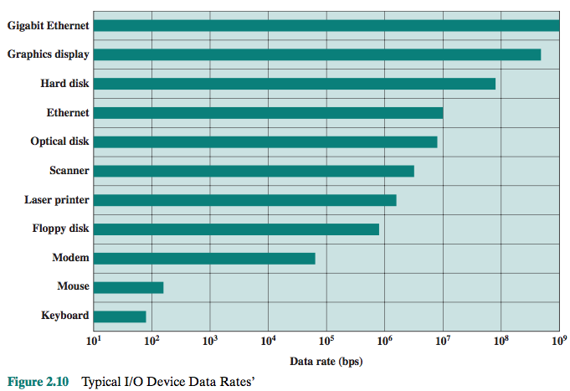
Typical I/O Device Data Rates

Slide 8
Performance balance
Designers constantly strive to balance the throughput and processing demands of the processor components, main memory, I/O devices, and the interconnection structures.

Slide 9
Improvements in Chip Organization and Architecture
Increase hardware speed of processor
Fundamentally due to shrinking logic gate size
More gates, packed more tightly, increasing clock rate
Propagation time for signals reduced
Increase size and speed of caches
Dedicating part of processor chip
Cache access times drop significantly
Change processor organization and architecture
Increase effective speed of instruction execution
Parallelism
Notes:
As designers wrestle with the challenge of balancing processor performance with that
of main memory and other computer components, the need to increase processor
speed remains. There are three approaches to achieving increased processor speed:
• Increase the hardware speed of the processor. This increase is fundamentally
due to shrinking the size of the logic gates on the processor chip, so that more
gates can be packed together more tightly and to increasing the clock rate.
With gates closer together, the propagation time for signals is significantly
reduced, enabling a speeding up of the processor. An increase in clock rate
means that individual operations are executed more rapidly.
• Increase the size and speed of caches that are interposed between the processor
and main memory. In particular, by dedicating a portion of the processor
chip itself to the cache, cache access times drop significantly.
• Make changes to the processor organization and architecture that increase the
effective speed of instruction execution. Typically, this involves using parallelism
in one form or another.

Slide 10
Problems with Clock Speed and Logic Density
Power
Power density (watts/cm²) increases with density of logic and clock speed
Dissipating heat
RC delay
Speed at which electrons flow limited by resistance and capacitance of metal wires connecting them
As components on the chip decrease in size, the wire interconnects become thinner, increasing resistance
Also, the wires are closer together, increasing capacitance
Delay increases as the RC product increases
Memory latency
Memory access speed (latency) and transfer speed (throughput)
Memory speeds lag processor speeds
Notes:
Traditionally, the dominant factor in performance gains has been in increases
in clock speed due and logic density. However, as clock speed and logic density
increase, a number of obstacles become more significant [INTE04b]:
• Power: As the density of logic and the clock speed on a chip increase, so does
the power density (Watts/cm2). The difficulty of dissipating the heat generated
on high-density, high-speed chips is becoming a serious design issue [GIBB04,
BORK03].
• RC delay: The speed at which electrons can flow on a chip between transistors
is limited by the resistance and capacitance of the metal wires connecting
them; specifically, delay increases as the RC product increases. As components
on the chip decrease in size, the wire interconnects become thinner, increasing
resistance. Also, the wires are closer together, increasing capacitance.
• Memory latency: Memory speeds lag processor speeds, as previously discussed.
Thus, there will be more emphasis on organization and architectural approaches
to improving performance. These techniques are discussed in later chapters of the book.

Slide 11
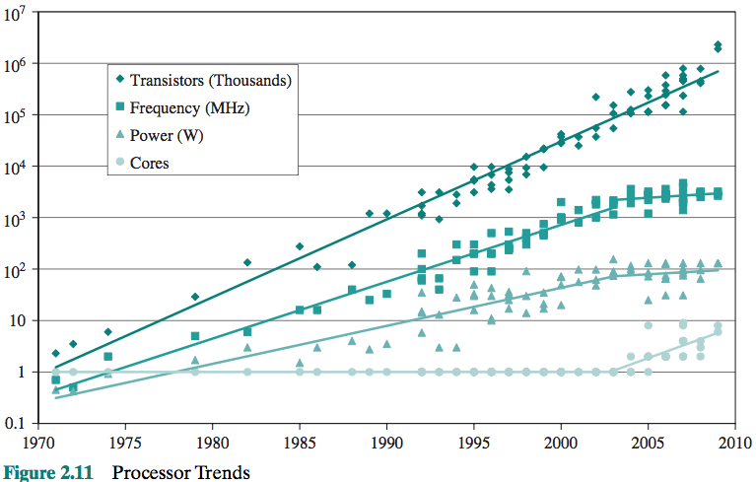

Slide 13
Organization and architecture approaches
Two main strategies have been used to increase performance beyond what can be achieved simply by increasing clock speed
Increase cache capacity and their incorporation on the processor chip
Parallel execution of instruction within the processor such as pipelining and superscalar
Both of these approaches have reached to point of diminishing returns
The recent approach is the development of multi-core chips

Slide 14
Multicore
The use of multiple processors on the same chip provides the potential to increase performance without increasing the clock rate
Strategy is to use two simpler processors on the chip rather than one more complex processor
With two processors larger caches are justified
As caches became larger it made performance sense to create two and then three levels of cache on a chip
Notes:
With all of the difficulties cited in the preceding paragraphs in mind, designers
have turned to a fundamentally new approach to improving performance: placing
multiple processors on the same chip, with a large shared cache. The use of multiple
processors on the same chip, also referred to as multiple cores, or multicore,
provides the potential to increase performance without increasing the clock rate.
Studies indicate that, within a processor, the increase in performance is roughly
proportional to the square root of the increase in complexity [BORK03]. But if the
software can support the effective use of multiple processors, then doubling the
number of processors almost doubles performance. Thus, the strategy is to use two
simpler processors on the chip rather than one more complex processor.
In addition, with two processors, larger caches are justified. This is important
because the power consumption of memory logic on a chip is much less than that of
processing logic.
As the logic density on chips continues to rise, the trend to both more cores
and more cache on a single chip continues. Two-core chips were quickly followed
by four-core chips, then 8, then 16, and so on. As the caches became larger, it made
performance sense to create two and then three levels of cache on a chip, with the
first-level cache dedicated to an individual processor and levels two and three being
shared by all the processors. It is now common for the second-level
cache to also be private to each core.

Slide 15
Amdahl’s Law
Gene Amdahl
Deals with the potential speedup of a program using multiple processors compared to a single processor
Illustrates the problems facing industry in the development of multi-core machines
Software must be adapted to a highly parallel execution environment to exploit the power of parallel processing
Can be generalized to evaluate and design technical improvement in a computer system
Notes:
Computer system designers look for ways to improve system performance by
advances in technology or change in design. Examples include the use of parallel
processors, the use of a memory cache hierarchy, and speedup in memory access
time and I/O transfer rate due to technology improvements. In all of these cases, it is
important to note that a speedup in one aspect of the technology or design does not
result in a corresponding improvement in performance. This limitation is succinctly
expressed by Amdahl’s law.
Amdahl’s law was first proposed by Gene Amdahl in 1967 ([AMDA67],
[AMDA13]) and deals with the potential speedup of a program using multiple processors
compared to a single processor.
Nevertheless, Amdahl’s law illustrates the problems facing industry in the development
of multicore machines with an ever-growing number of cores: The software
that runs on such machines must be adapted to a highly parallel execution environment
to exploit the power of parallel processing.
Amdahl’s law can be generalized to evaluate any design or technical improvement
in a computer system.

Slide 16
Notes:
Consider a program running on a single processor such that a fraction
(1 – f) of the execution time involves code that is inherently serial and a fraction
f that involves code that is infinitely parallelizable with no scheduling overhead.
Let T be the total execution time of the program using a single processor. Then the
speedup using a parallel processor with N processors that fully exploits the parallel
portion of the program is as follows:
Speedup =
Time to execute program on a single processor
Time to execute program on N parallel processors
=T(1 - f) + Tf
T(1 - f) +Tf
N
= 1
(1 - f) +f
N
This equation is illustrated in Figures 2.3 and 2.4.

Slide 17
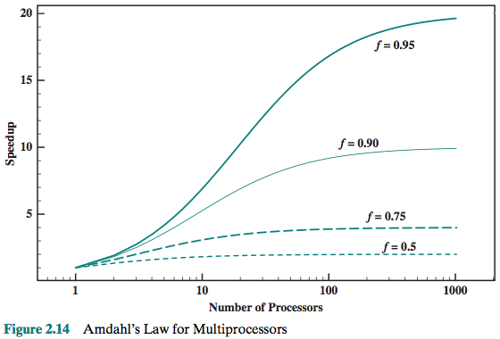

Slide 18
Videos
Parallel Computing
https://www.youtube.com/watch?v=q7sgzDH1cR8
Distributed Systems
https://www.youtube.com/watch?v=rYK-kTBUrK4
Amdahl’s Law
https://www.youtube.com/watch?v=WdRiZEwBhsM
Lawn Mower Law
https://www.youtube.com/watch?v=ehyO7mxeU74

Slide 19
Little’s law
The general setup is that we have a steady state system to which items arrive at an average rate of λ items per unit time.
The items stay in the system an average of W units of time.
Finally, there is an average of L units in the system at any one time.
Little’s Law relates these three variables as L = λW.

Slide 20
Videos
https://www.youtube.com/watch?v=aVFF2hWy1-Y
https://www.youtube.com/watch?v=YaI01-1vV0M

Slide 21
Clock speed
Typically, clock signals are generated by a quartz crystal, which generates a constant sine wave while power is applied. This wave is converted into a digital voltage pulse stream that is provided in a constant flow to the processor circuitry
For example, a 1-GHz processor receives 1 billion pulses per second. The rate of pulses is known as the clock rate, or clock speed. One increment, or pulse, of the clock is referred to as a clock cycle, or a clock tick. The time between pulses is the cycle time.

Slide 22
Notes:
Operations performed by a processor, such as fetching an
instruction, decoding the instruction, performing an arithmetic operation, and so
on, are governed by a system clock. Typically, all operations begin with the pulse of
the clock. Thus, at the most fundamental level, the speed of a processor is dictated
by the pulse frequency produced by the clock, measured in cycles per second, or
Hertz (Hz).
Typically, clock signals are generated by a quartz crystal, which generates a
constant sine wave while power is applied. This wave is converted into a digital
voltage pulse stream that is provided in a constant flow to the processor circuitry
(Figure 2.5). For example, a 1-GHz processor receives 1 billion pulses per second.
The rate of pulses is known as the clock rate, or clock speed. One increment, or
pulse, of the clock is referred to as a clock cycle, or a clock tick. The time between
pulses is the cycle time.
The clock rate is not arbitrary, but must be appropriate for the physical layout
of the processor. Actions in the processor require signals to be sent from one processor
element to another. When a signal is placed on a line inside the processor, it
takes some finite amount of time for the voltage levels to settle down so that an
accurate value (1 or 0) is available. Furthermore, depending on the physical layout
of the processor circuits, some signals may change more rapidly than others. Thus,
operations must be synchronized and paced so that the proper electrical signal
(voltage) values are available for each operation.
The execution of an instruction involves a number of discrete steps, such
as fetching the instruction from memory, decoding the various portions of the
instruction, loading and storing data, and performing arithmetic and logical operations.
Thus, most instructions on most processors require multiple clock cycles to
complete. Some instructions may take only a few cycles, while others require dozens.
In addition, when pipelining is used, multiple instructions are being executed simultaneously.
Thus, a straight comparison of clock speeds on different processors does
not tell the whole story about performance.

Slide 23
A processor is driven by a clock with a constant frequency f or, equivalently, a constant cycle time t, where t = 1/f,
instruction count, I_{c}, for a program as the number of machine instructions executed for that program until it runs to completion or for some defined time interval,
p is the number of processor cycles needed to decode and execute the instruction,
m is the number of memory references needed, and k is the ratio between memory cycle time and processor cycle time.
Notes:
Table 2.1 is a matrix in which one dimension shows the five
performance factors and the other dimension shows the four system attributes. An
X in a cell indicates a system attribute that affects a performance factor.
A common measure of performance for a processor is the rate at which
instructions are executed, expressed as millions of instructions per second (MIPS),
referred to as the MIPS rate.
Another common performance measure deals only with floating-point instructions.
These are common in many scientific and game applications. Floating-point
performance is expressed as millions of floating-point operations per second
(MFLOPS).

Slide 24
Table 2.1 Performance Factors and System Attributes
Notes:
Table 2.1 is a matrix in which one dimension shows the five
performance factors and the other dimension shows the four system attributes. An
X in a cell indicates a system attribute that affects a performance factor.
A common measure of performance for a processor is the rate at which
instructions are executed, expressed as millions of instructions per second (MIPS),
referred to as the MIPS rate.
Another common performance measure deals only with floating-point instructions.
These are common in many scientific and game applications. Floating-point
performance is expressed as millions of floating-point operations per second
(MFLOPS).

Slide 25
Cycles Per Instruction
Let CPI_{i} be the number of cycles required for instruction type i and Ii be the number of executed instructions of type i for a given program. Then we can calculate an overall CPI as follows:
The processor time T needed to execute a given program can be expressed as

Slide 26
MIPS rate
A common measure of performance for a processor is the rate at which instructions are executed, expressed as millions of instructions per second (MIPS), referred to as the MIPS rate. We can express the MIPS rate in terms of the clock rate and CPI as follows:

Slide 27
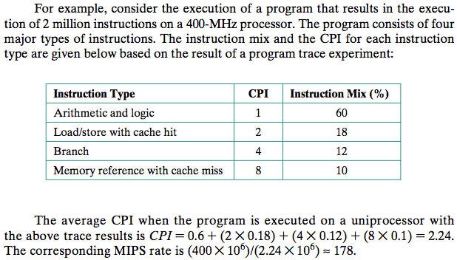
Example

Slide 28

MFLOPS rate

Slide 29
Videos
https://www.youtube.com/watch?v=MyXAjSTwEQM
https://www.youtube.com/watch?v=K49alUpbtz8

